Slide 1
Regression Modeling and Performance Evaluation MSCS-634-B01 Advanced Big Data and Data Mining
Objective: To analyze and model the Diabetes dataset using regression, classification, clustering, and pattern mining techniques.
Dataset: Pima Indian Diabetes Dataset (UCI Repository)
Tools Used: Python, Pandas, Scikit-learn, Matplotlib, Seaborn, MLxtend

Slide 2
Dataset Summary
Observations: 768 records, 8 numerical features, 1 binary target
Features: Glucose, BMI, Age, Insulin, Blood Pressure, etc.
Target: Outcome (1 = Diabetic, 0 = Non-diabetic)
Reason for Selection: Real-world healthcare relevance and suitability for classification/clustering.

Slide 3
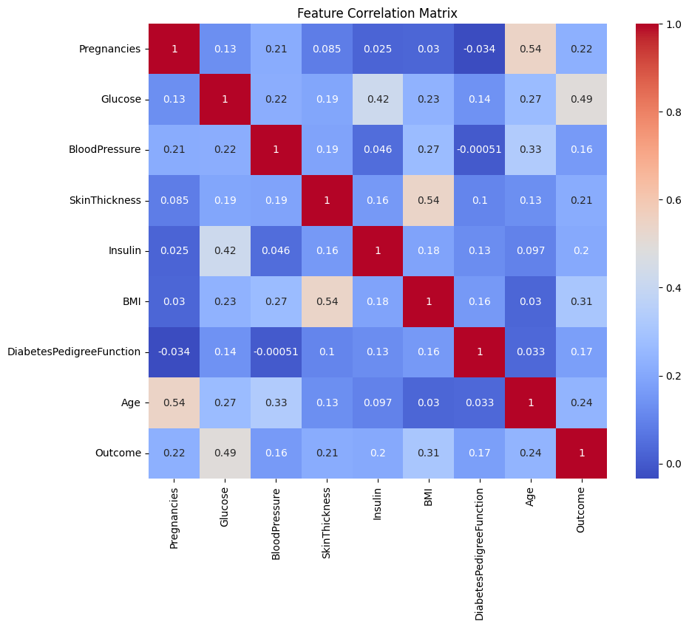
Data Preprocessing & EDA
Missing Values: Replaced zeros in key features with means
Outliers: Handled via boxplot and Z-score
Standardization: Applied to all features
Insights:
High glucose and BMI → Higher diabetes risk
Moderate correlation from Age and Pregnancies

Slide 4
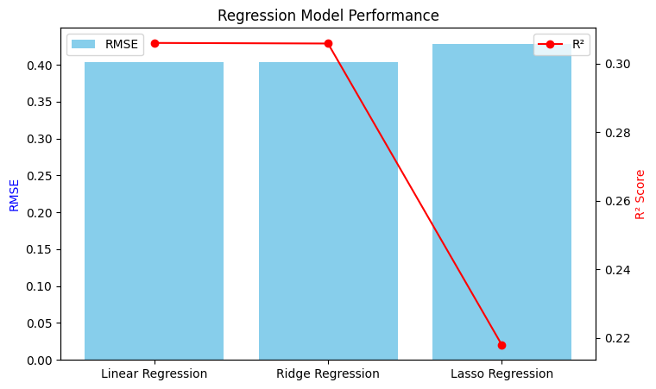
Regression Analysis
Models: Linear, Ridge, Lasso
Metrics: RMSE, R²
Findings:
Regularization improved performance
Glucose and BMI had strongest coefficients

Slide 5
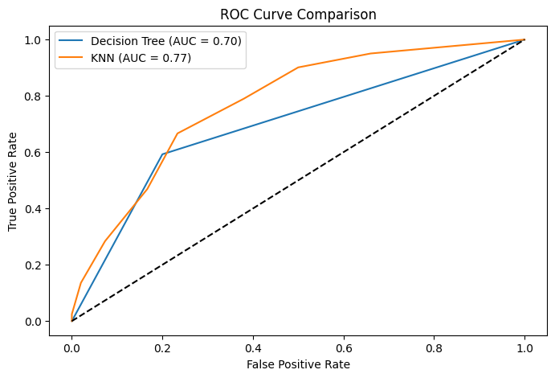
Classification & Tuning
Algorithms: Decision Tree, k-NN, Naïve Bayes
Tuning:
GridSearchCV for k-NN (Best k = 7)
Depth tuning for Decision Tree
Performance:
Accuracy ~78% (k-NN)
ROC, F1-Score, Confusion Matrix used for evaluation

Slide 6
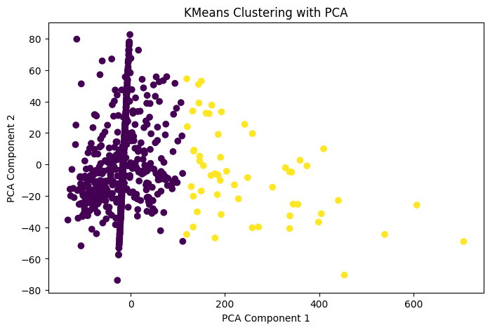
Clustering & Association Rules
Clustering:
K-Means (k=2) → Grouped diabetic vs. non-diabetic
PCA used for visualization
Apriori Rules:
Discovered strong rules like: {Glucose=High, BMI=High} → {Outcome=1}

Slide 7
Final Insights & Recommendations
Key Insights:
Glucose & BMI → Major predictors
k-NN was best classifier
Recommendations:
Use in clinical screening tools
Focus intervention on high-risk profiles
Ethics:
No personal data used
Addressed class imbalance for fairness

